Slide 1
EDA part

Slide 2
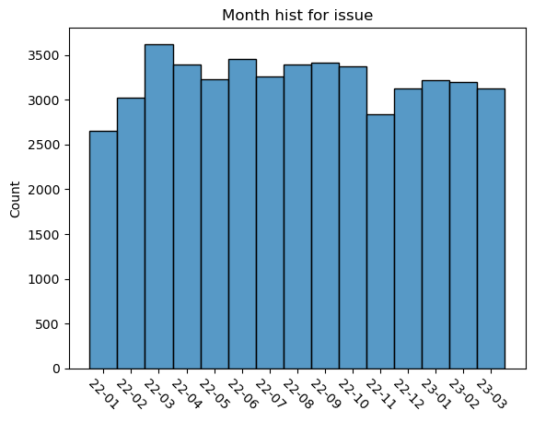
we first observeing the structure of data.
ISSUE_DATE
It seems that the month distribution are equal.
It has been checked that all the issue-date is in year 2022 and 2023.

Slide 3
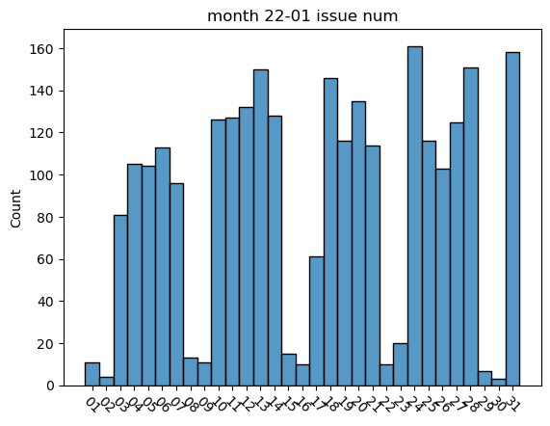
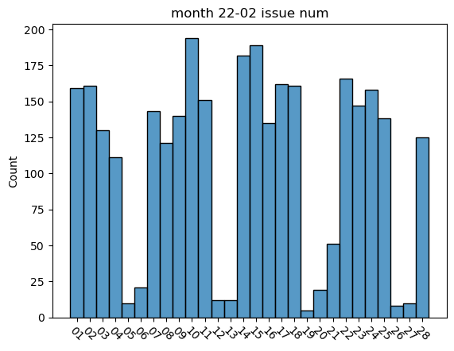
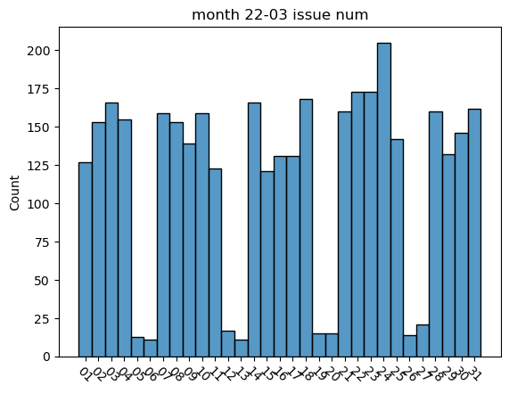
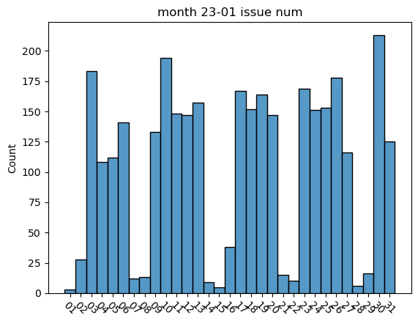
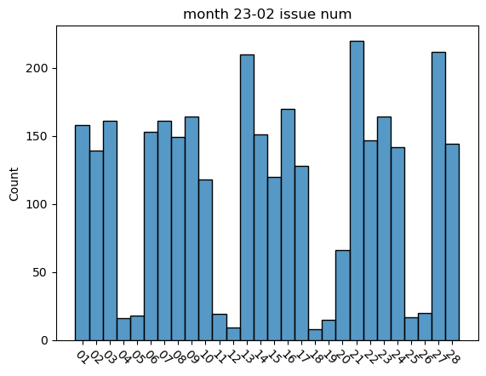
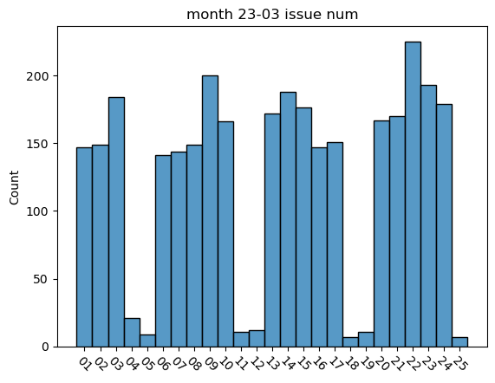
ISSUE_DATE month-distribution by date

Slide 4
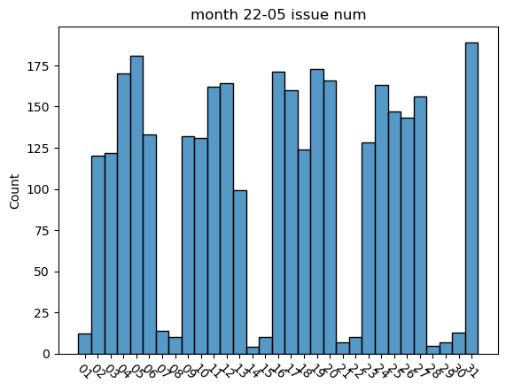
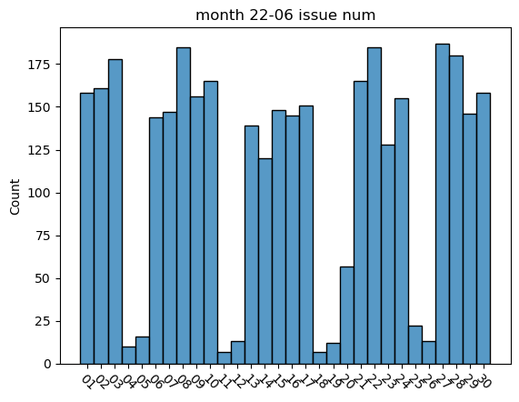
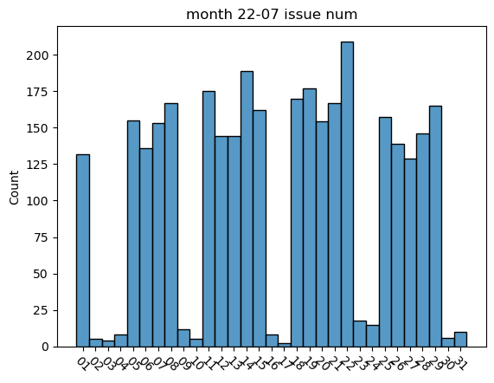
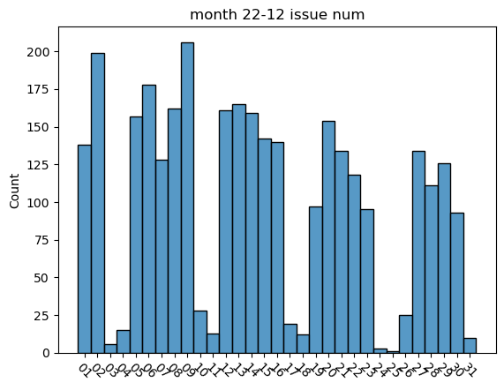
ISSUE_DATE distribution by date after 22-03 and before 2023
……
ISSUE_DATE distribution by month after 22-03 is almost the same pattern as before.
Comparing the pictures we finally find that all days with few issue numbers seems all weekends, the reason may be just this simple.

Slide 5
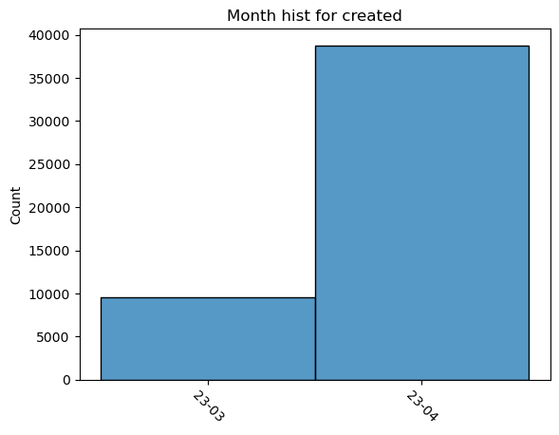
CREATED_DATE distribution by month
We find that there's only two months' data in created date. The CREATED_DATE are all in one time 2023-04-17 10:36:16+00:00 and 2023-03-28 10:37:25+00:00.
The created-date should be the date we download the data, we do not need to pay more attention later.

Slide 6
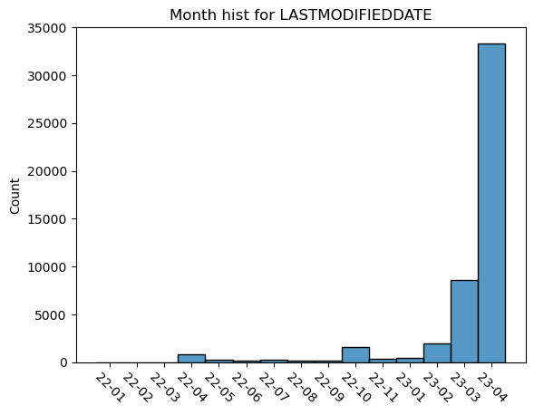
LASTMODIFIEDDATE distribution by month
We found that the last modifieddate data is apparently increasing in last three months.

Slide 7
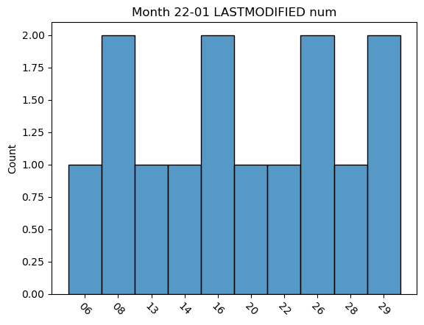
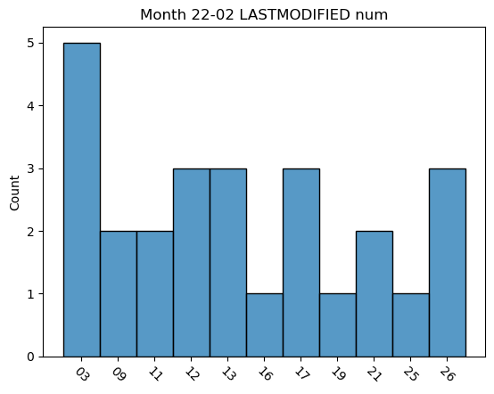
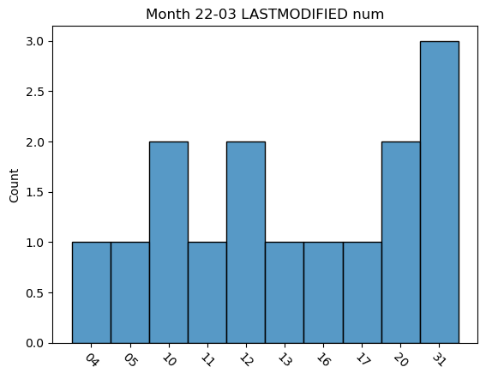
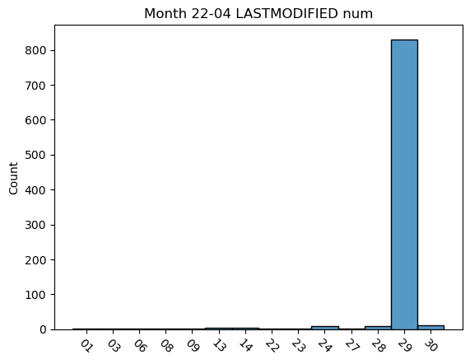
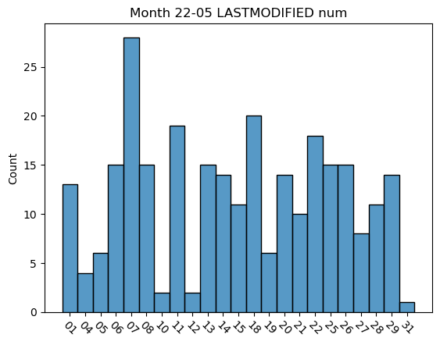
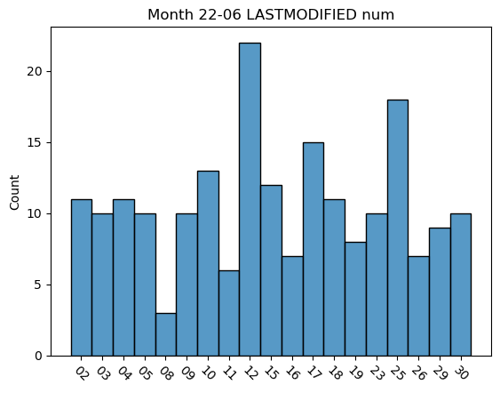
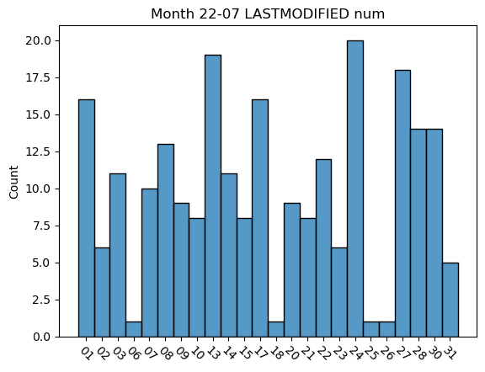
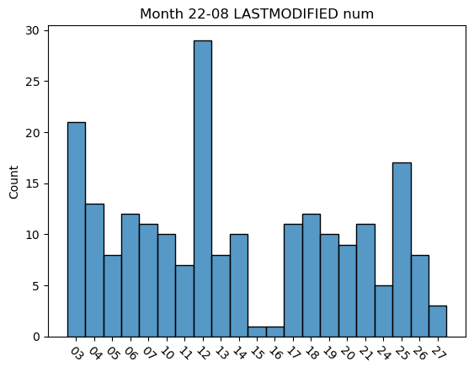
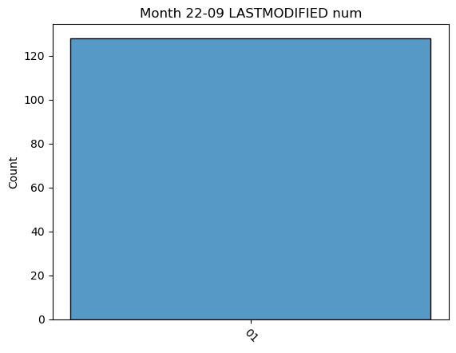
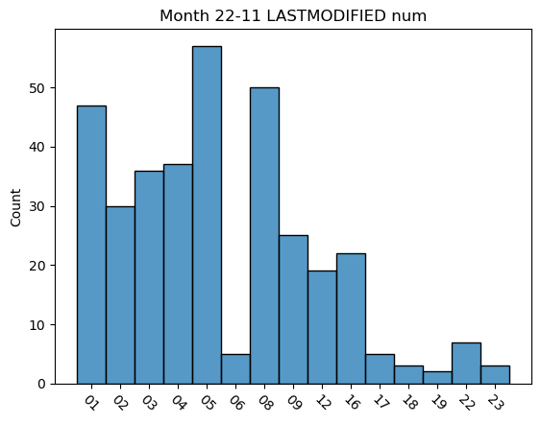
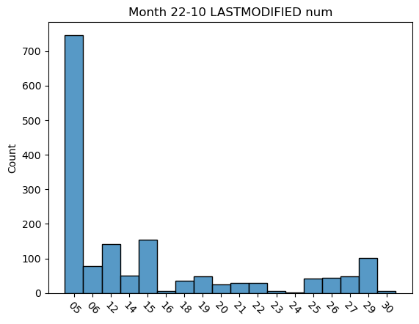
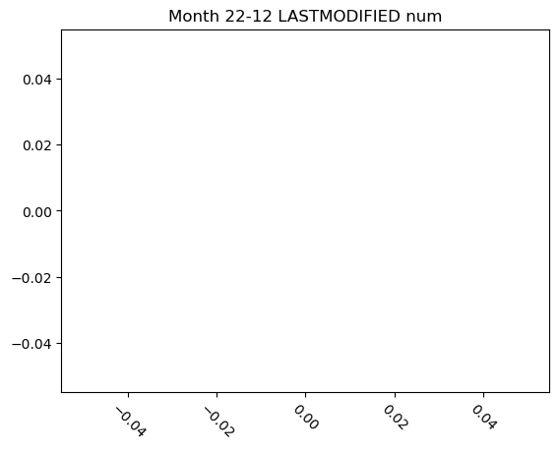
LASTMODIFIEDDATE month-distribution by date
We do not find any pattern in them.

Slide 8
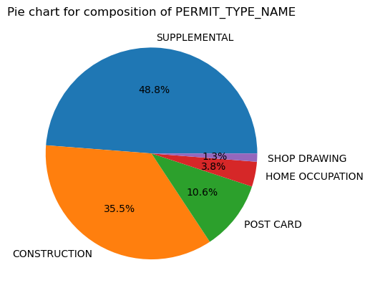
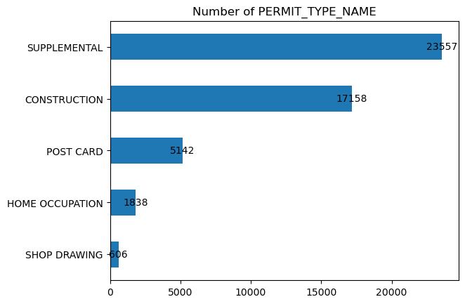
PERMIT_TYPE_NAME distribution
The pie chart shows that 35.5% of building-permits are construction which is the number 17158

Slide 9
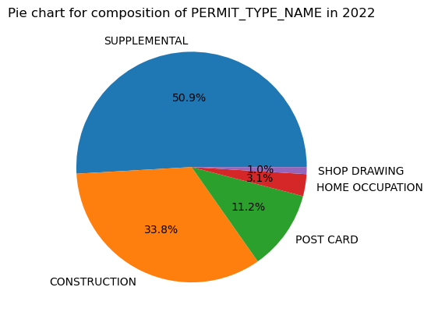
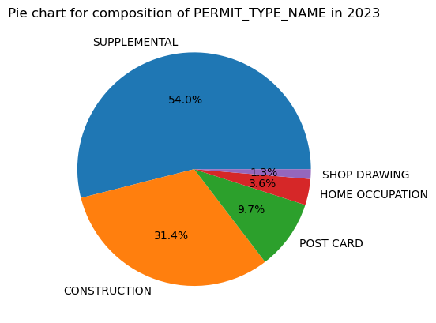
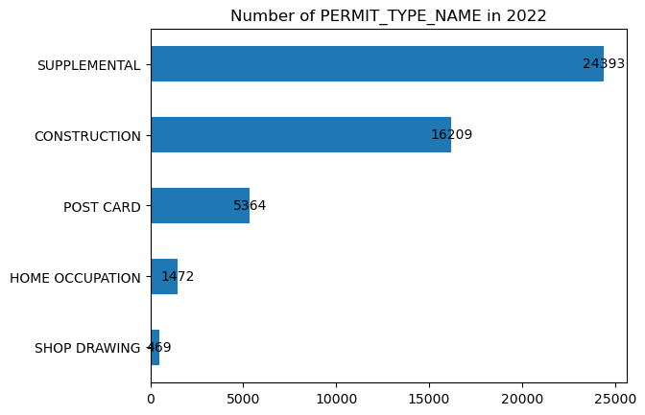
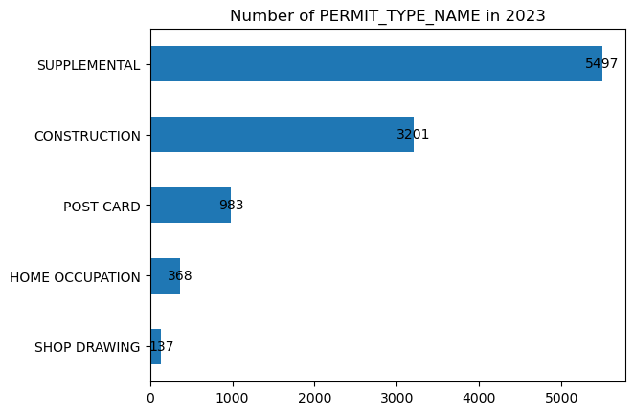
PERMIT_TYPE_NAME distribution
The pie charts show that the distribution in permit_type_name seem to remain approximately stable. Construction occupy 1/3 of them.

Slide 10
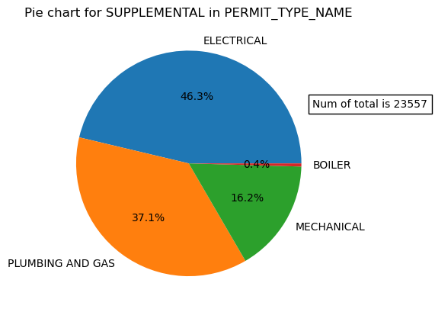
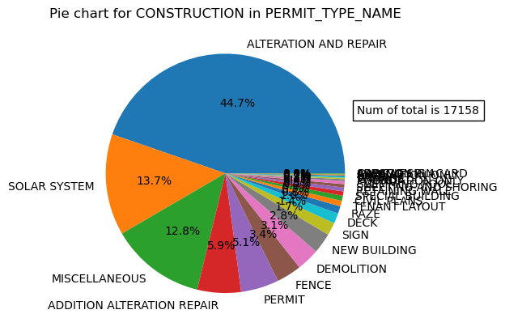
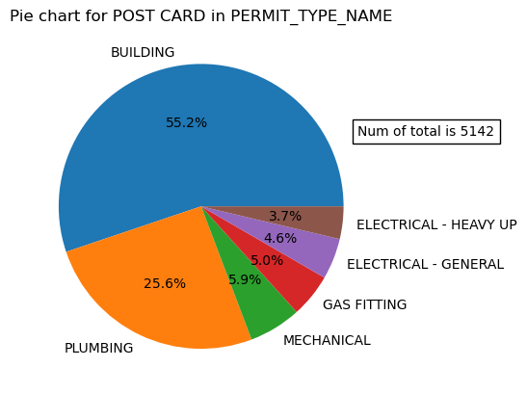
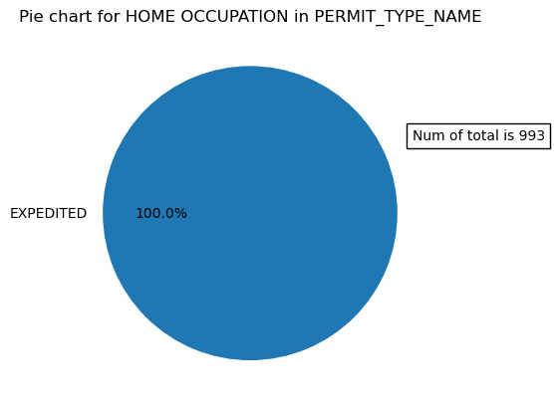
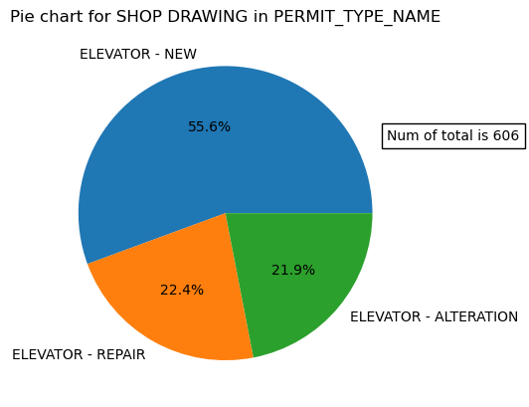
Pie charts for PERMIT_SUBTYPE_NAME
There are many sub-type in constructions.

Slide 11
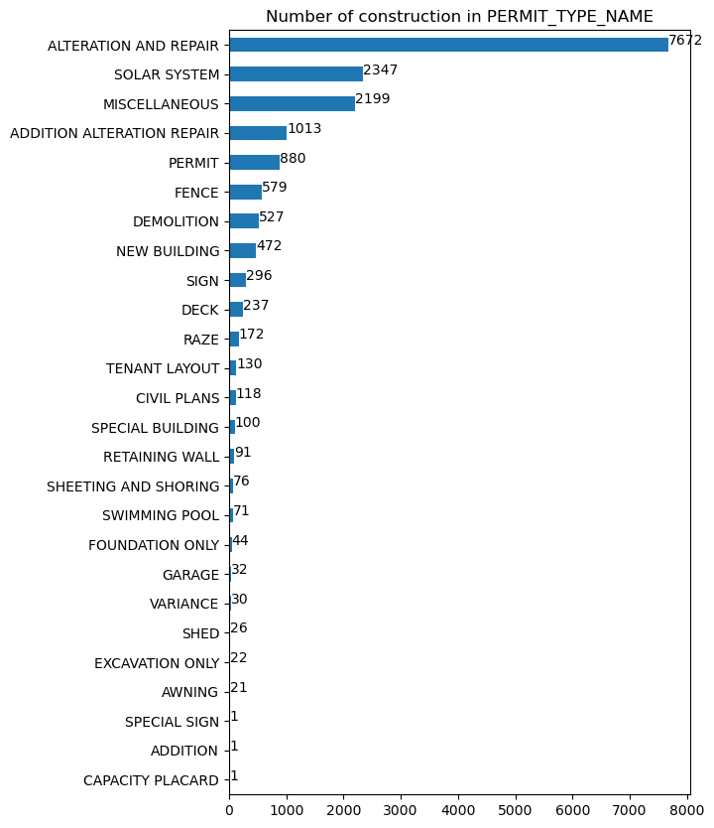
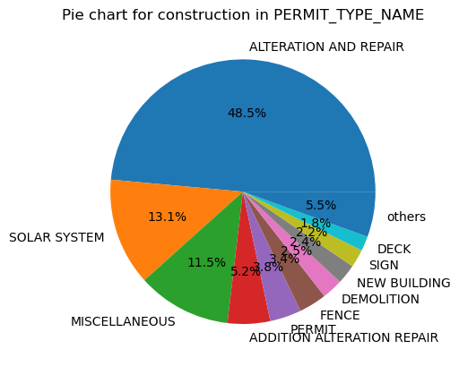
Pie charts for construction PERMIT_SUBTYPE_NAME
The propotions of items in others are less than 1.4%.
others: ['RAZE' 'TENANT LAYOUT' 'CIVIL PLANS' 'SPECIAL BUILDING' 'RETAINING WALL' 'SHEETING AND SHORING' 'SWIMMING POOL' 'FOUNDATION ONLY' 'GARAGE' 'VARIANCE' 'SHED' 'EXCAVATION ONLY' 'AWNING' 'ADDITION' 'SPECIAL SIGN' 'CAPACITY PLACARD']

Slide 12
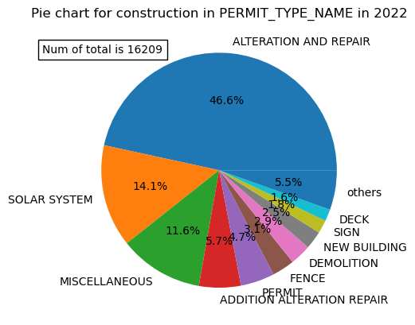
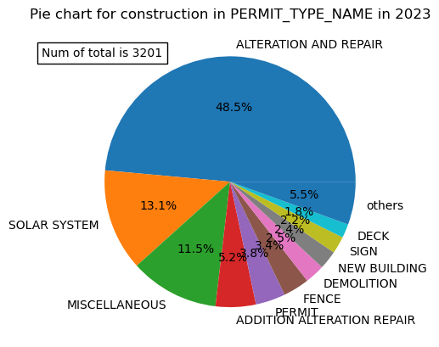
Pie charts for construction PERMIT_SUBTYPE_NAME
The proportion seems to be stable in construction by year.

Slide 13
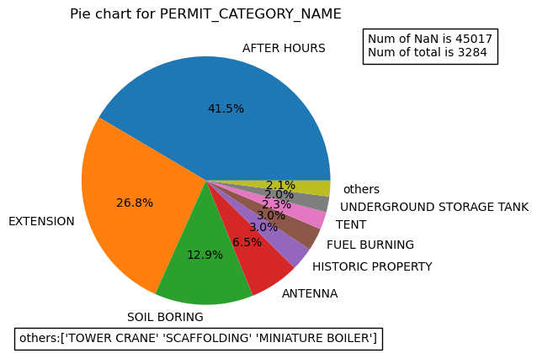
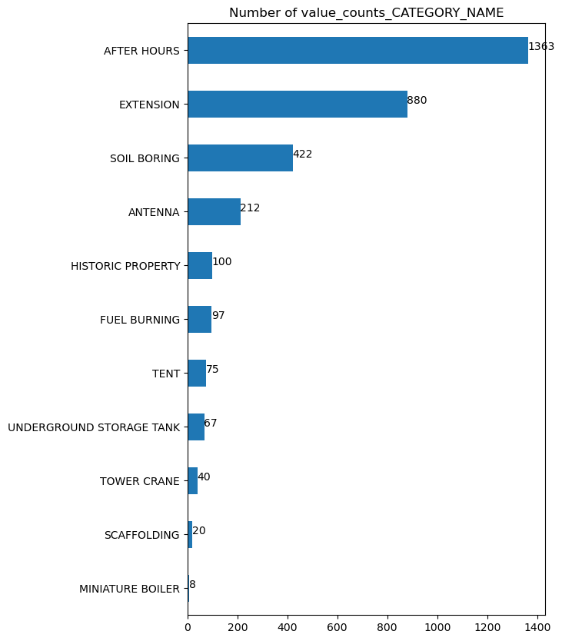
PERMIT_CATEGORY_NAME distribution by month
After Hours and Extension occupy the most in permit_category_name.

Slide 14
There are 47.26% of the building-permits have PERMIT_APPLICANT in table, others are empty.
There are 33.60% of the construction have PERMIT_APPLICANT in table, others are empty.
There are 0 of NaN data in FEES_PAID, and 796 of them haven't paid yet for building-permits.
There are 0 of NaN data in FEES_PAID, and 346 of them haven't paid yet for construction.
There are 94.47% of the building-permits have a owner or more in table, others are empty.
There are 33.07% of the construction have a owner or more in table, others are empty.

Slide 15
Correlation
By correlation matrix:
There is a strong correlation between ['X-LONGITUDE', 'X-XCOORD', 'Y-LATITUDE', 'Y-YCOORD', 'LATITUDE-YCOORD', 'LONGITUDE-XCOORD']
By T-test:
p-value:0.9924114165509489>0.05, maximum distance of X and LONGITUDE:0.2580238065661433 meter(1degree is 111km)
p-value:0.9700610590243042>0.05, maximum distance of Y and LATITUDE:0.8667890658458077 meter
We believe there are no difference between X-LONGITUDE, Y-LATITUDE.

Slide 16
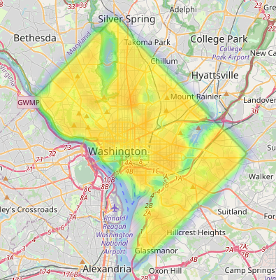
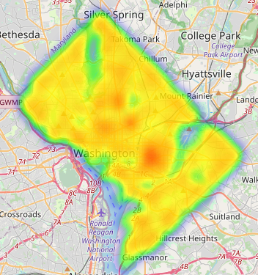
Heat-map
Heat map for building_permits
Heat map for construction

Slide 17
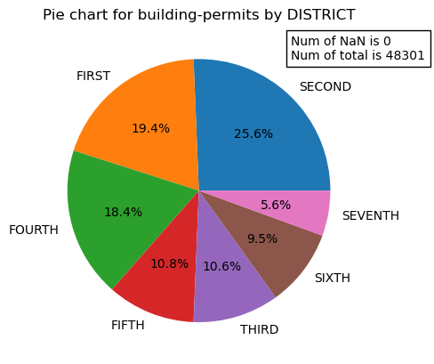
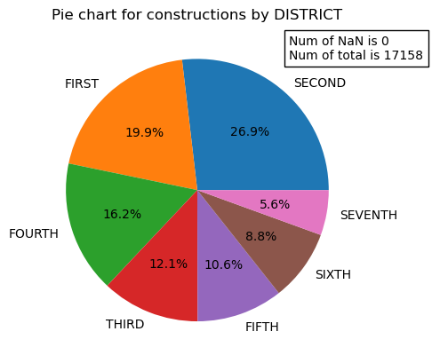
Distribution by district.
It shows that the distribution in building-permits and constructions are similar by district. District second, first and fourth occupy the first three.

Slide 18
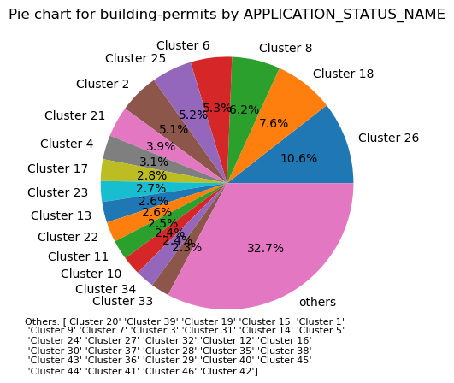
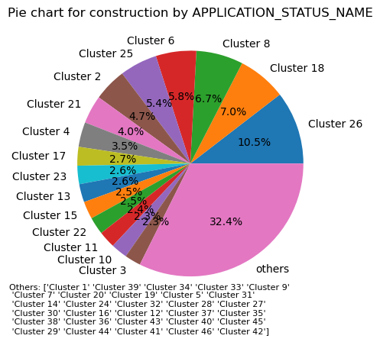
Distribution by NEIGHBORHOODCLUSTER

Slide 19
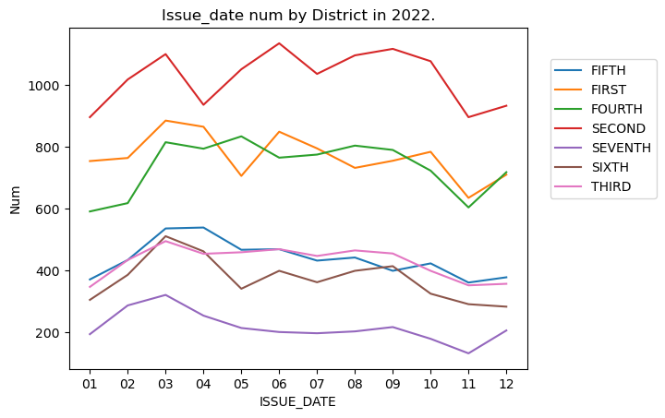
ISSUE_DATE by District

Slide 20
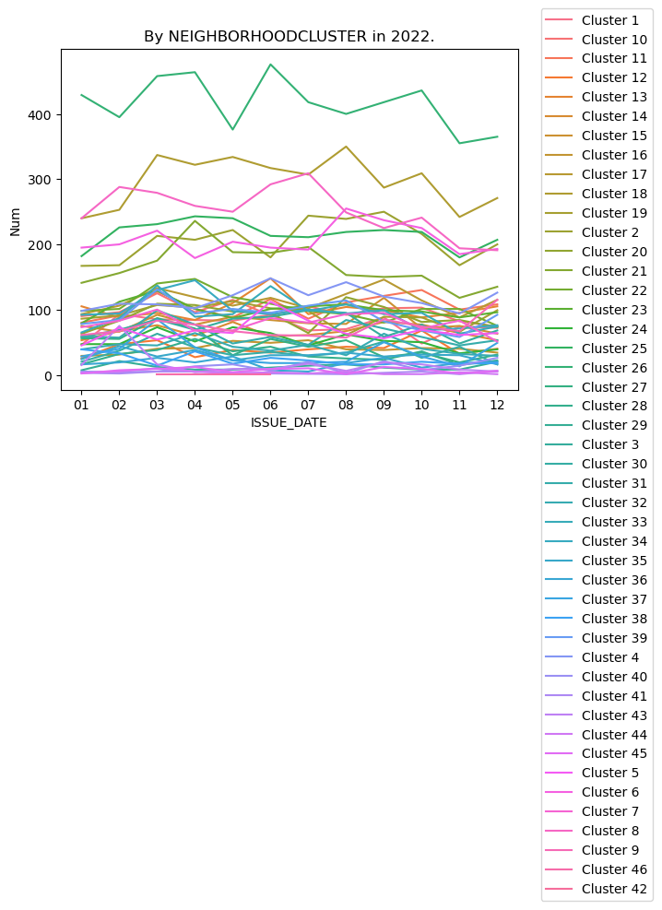

ISSUE_DATE by Neighbourhoodcluster
Cluster 26,18,8 occupy the first three Neighbourhood by issue-date.

